Slide 1
TOP-DOWN APPROACH

Slide 2
Table of Contents
1
2
3
4
Introduction
Processes in Top-Down
Approach
Pros and Cons of
Top-Down Approach
Conclusion

Slide 3
1
Introduction

Slide 4
Problem
When starting to solve a complex problem, deciding which method to apply is very important to ensure efficiency and timeliness. The top-down approach is a good example of this approach.

Slide 5
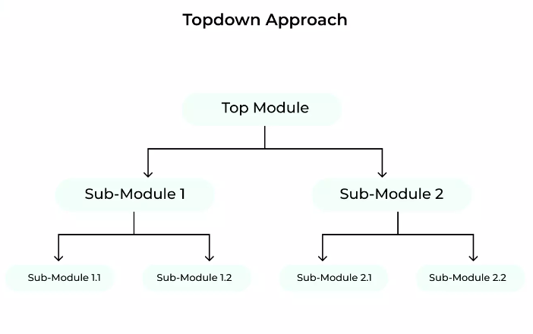
Concept
The top-down approach involves breaking down a large, complex problem or system into smaller, more manageable parts and then treating each part individually.
This approach is often used to develop software systems because it allows developers to focus on one part of the system at a time, which can make the development process more organized and efficient.

Slide 6
2
Processes

Slide 7
Processes in Top-Down approach
Step 1: Define the overall system requirements
The first step is to define the overall goals and objectives of the system, as well as any specific requirements or constraints.
Step 2: Break down the system into smaller components
Next, the system is broken down into smaller, more manageable components or modules.
Big Idea
Part I
Part II
Part III

Slide 8
Processes in Top-Down approach
Step 3: Develop each component individually
Once the system has been divided into smaller components, each component can be developed individually.
The final design might look something like this organizational chart, showing the overall structure of separate units that form a single complex entity.
Big Idea
Part I
Part II
II.A
II.B
II.B.1
II.C
Part III
III.A
III.B

Slide 9
3
Pros and Cons

Slide 10
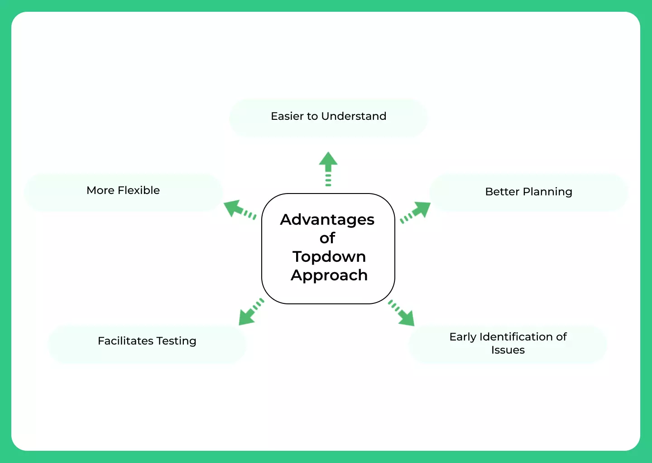
Advantages of Top-Down approach

Slide 11

Pros of Top-Down approach
Increased clarity: Top-down approaches provide a bird's-eye view of the problem, giving the problem solver a better understanding of the overall situation.
Improved planning: Top-down approaches help the problem solver identify overall goals and objectives. This helps them to plan better for solving the problem.
Greater flexibility: Top-down approaches allow the problem solver to change plans as needed. This is especially helpful in situations that are rapidly changing.
Earlier problem detection: Top-down approaches help the problem solver to detect potential problems early. This helps them to address these problems before they become serious.
More reliable testing: By testing from the top down, this helps ensure that no important areas are missed.

Slide 12
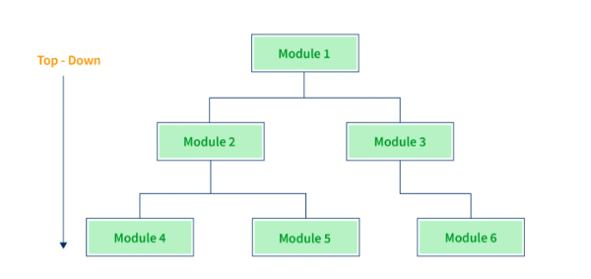
Cons of Top-Down approach
It can be time-consuming:
Breaking down the big picture into smaller pieces can take a lot of time, especially if the design is complex.
It can be costly:
The top-down approach may require more resources upfront, as all of the planning and design work needs to be done before the project can be implemented.
It can be difficult to manage:
With so many pieces and components, it can be challenging to keep track of everything and ensure that everything is working together as intended.

Slide 13
4
Conclusion

Slide 14
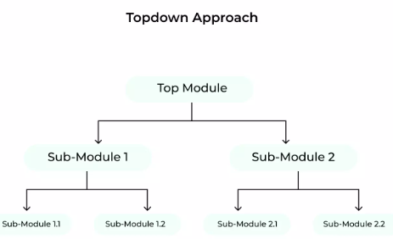
Conclusion
The top-down approach is a crucial methodology in problem-solving and system design.
By starting with a broad overview and gradually delving into details, this method helps create an organized, manageable, and efficient system.

Slide 15

Thanks!
tdpvinh@gmail.com

